Slide 1
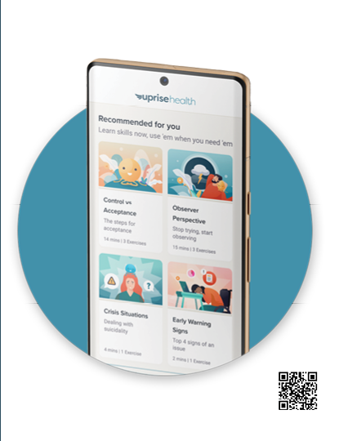
Employee Assistance Program (EAP)
Our program is designed to help reduce stress and keep you healthy.
Bite-sized training is available from your desktop.
Access is confidential.
Skills training to develop your resilience, stress
management, and mental fitness.
Visit members.uprisehealth.com to get started.
© Uprise Health

Slide 2
Your EAP is For You & Your Family.
EAP benefits are available to all employees and their families at NO COST to you. The EAP offers confidential advice, support, and practical solutions to real-life issues.
EAP Services for Employees & Families
Up to Confidential Counseling Sessions
24-hour Crisis Help
Online Peer Support Groups
Tess, AI Chatbot
Phone: 1-800-395-1616
Website: app.uprisehealth.com
Access Code:
© Uprise Health

Slide 3
We Are Here to Help.
You, your spouse, and dependents have access to no-cost, confidential counseling and work-life
resources for personal concerns through the Uprise Health EAP:
Financial Help
Legal Services
Online Legal Forms
Child & Parenting Services
Adult & Eldercare Services
Webinars & Trainings
Our EAP is here to help. Anytime. Anywhere.
Connect with an intake specialist who can help you
find the resources and services you need.
Phone: 1-800-395-1616
Website: app.uprisehealth.com
Access Code:
© Uprise Health

Slide 4
Life presents us with challenges at work and at home on a daily basis. You do not have to face these challenges alone, even if you’re far away.
EAP benefits are available to all employees
and their families at NO COST to you.
You can access these confidential services by calling 1-800-395-1616 and speaking with an intake specialist or by accessing online at app.uprisehealth.com.
Phone: 1-800-395-1616
Website: app.uprisehealth.com
Access Code:
© Uprise Health

Slide 5
Phone: 1-800-395-1616
Website: app.uprisehealth.com
Access Code:
© Uprise Health

